Slide 1

The Simplest Classification: Naive Bayes
Uday Keith

Slide 2
Probabilistic Modelling
For classification problems, we are often dependent on probabilistic models. That is models that calculate the probability of something belonging to a class.
We have already encountered a probabilistic model, Logistic Regression.
Logistic regression involves directly modeling Pr(Y = k|X = x) using the logistic function,for the case of two response classes. In statistical jargon, we model the conditional distribution of the response Y , given the predictor(s).
Today we will consider another probabilistic approach to calculate the same probability Pr(Y = k|X = x), Naive Bayes.

Slide 3
Probabilistic Modelling
Suppose that we wish to classify an observation into one of K classes, where K ≥ 2.
The probability that a given observation is associated with the kth category of the response variable Y is called the prior probability.
Estimating the prior is easy if we have a random sample of Y’s from the population: we simply compute the fraction of the training observations that belong to the kth class.
We refer to p_{k}(x) as the posterior probability that an observation belongs to the kth class. That is, it is the probability that the observation belongs to the kth class, given the predictor value for that observation.
Lets look at a concrete example next.

Slide 4
Probabilistic Modelling
We want to understand which employee in a company has written a certain email. This email has three salient words: “Important”, “Successful” and “Salute”. We have two possible suspects, A and B.
Look at their historical emails, we find that A has “Important” in 10% of his emails, “Successful” in 80% and “Salute”, 10%. B has “Important” in 50% of his emails, “Successful” in 20% and “Salute”, 30%.
So currently, our prior probability of who wrote the email of we have K = 2 is P(A) = P(B) = 0.5
What about the posterior probability of who wrote the email given each of those words? What is P(A|X=”Salute”)? To calculate this, we use Baye’s theorem.

Slide 5
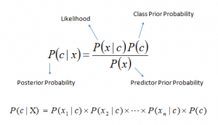
Probabilistic Modelling
Bayes Theorem
Here, P(c) is our prior and P(c|x) is our posterior. So, lets calculate, P(A|X=”Salute”). So P(A) = 0.5, P(B) = 0.4 and P(X=”Saute”||A) = 0.1. So, the answer here is 0.125. Lets calculate the same for all the words.
Now who wrote the email if an email contained all three words?

Slide 6
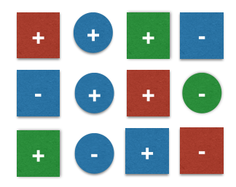

Probabilistic Modelling
Lets take another example, consider the following diagram
The task her is to calculate the prob. Of observing our 13th toy as
Here our class is (-) or (+) the shapes and colors are features.

Slide 7
Probabilistic Modelling
Under the naive assumption that the features “color” and “shape” are mutually independent, the class-conditional probabilities can be calculated as a simple product of the individual conditional probabilities.
Our decision rule is as follows:
Classify sample as + if P(ω=+∣x=[blue, square])≥P(ω=-∣x=[blue, square]) else classify sample as − . So now, calculate each.

